Slide 1
CSE7302 - INTERNSHIP
Review-II Presentation
CLIENT SUCCESS INTERN
Student Details
Name | ADWAITH SAI KRISHNA PANDA
Roll No | 20221CBC0017
Section | 8 CBC-1
Under the Supervision of,
Dr. Shanmugarathinam G
Professor,
Presidency School of CSE
Presidency University
Name of the Program: B.Tech
Name of the HoD: Dr. Pravinth Raja
Name of the Program Internship Coordinator: Ms Nisha Robin Rohit
Name of the School Internship Coordinator: Dr. Md Ziaur Rahman

Slide 2
Content
About Company or Organization
Working domain or the technology
About your team and reporting Manager
Challenges Faced in Internship
Objectives of the work
Proposed System
Problem Statement
System Requirements
Advantages of proposed System
Internship Roadmap
Github Link

Slide 3
About Company or Organization
Talent Recruit is an advanced Recruitment and Onboarding platform designed to simplify, automate, and enhance the entire hiring lifecycle. It leverages cutting-edge technologies such as Machine Learning and Artificial Intelligence to help organizations attract, screen, evaluate, and hire the right talent efficiently and accurately.
One of its key highlights is ERIKA – the 24×7 Robotic Recruiter, which automates candidate engagement, interview scheduling, follow-ups, and communication, ensuring a seamless and responsive recruitment experience for both recruiters and candidates. ERIKA reduces manual effort, improves turnaround time, and enhances candidate satisfaction through continuous availability and intelligent interaction.
Talent Recruit enables recruiters to manage job postings, track applications, shortlist candidates, conduct assessments, schedule interviews, and complete onboarding processes within a single integrated platform. Its AI-driven analytics and smart recommendations help recruiters make data-driven hiring decisions, minimize bias, and improve overall hiring quality.

Slide 4
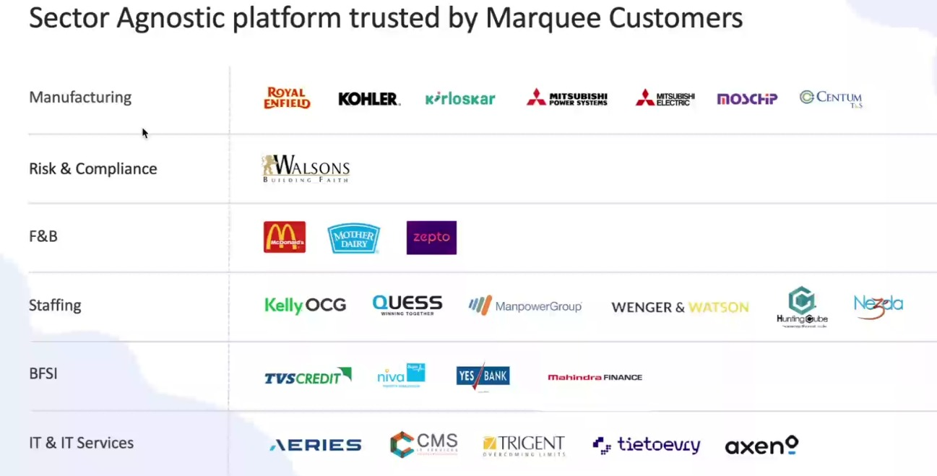
Our Clients

Slide 5
Working domain or the technology
Artificial Intelligence (AI) for intelligent recruitment automation
Machine Learning (ML) for resume screening and candidate ranking
Natural Language Processing (NLP) for chatbot and candidate interaction
Applicant Tracking System (ATS) architecture
SaaS (Software as a Service) cloud-based platform model
Database Management Systems for candidate and job data storage
REST APIs for integration with job portals and communication tools
Chatbot Technology (ERIKA – Robotic Recruiter)
Recruitment Analytics and Reporting Dashboards
Workflow Automation Systems

Slide 6
About your team and reporting Manager
Team Structure, Project, Reporting & Technology Understanding
Our team consists of 9 members, guided by our Reporting Manager, Mr. Ashish Meridatta.
Currently, we are in the training phase on the company’s ATS (Applicant Tracking System) product.
We are learning how each technology supports the recruitment process:
Technology Understanding:
AI & ML: Helps in resume screening and candidate ranking.
NLP: Enables chatbot communication and candidate interaction.
ATS Workflow: Helps track candidates across hiring stages.
Databases: Store and manage candidate and job data.
APIs: Integrate job portals and communication tools.
Dashboards & Analytics: Provide recruitment performance insights.
This training helps us understand how technology solves real recruitment challenges.
After training, we will be assigned to live projects for practical client exposure.

Slide 7
Challenges Faced in Internship
I was selected through my college campus placement process. Clearing the interview with the company’s CCO was a major challenge, as it involved in-depth technical questions, role-based scenarios, and problem-solving assessments. This experience tested my analytical thinking, technical knowledge, and ability to perform under pressure, helping me gain confidence and clarity about industry expectations.

Slide 8
Objectives of the work
To understand ATS system architecture and recruitment workflows.
To support AI-based resume parsing and candidate shortlisting processes.
To assist in database validation and candidate data management.
To ensure accurate workflow automation across hiring stages.
To support API-based integrations with job portals and communication tools.
To analyze recruitment dashboards and system reports.
To help in identifying and resolving basic system-level issues.
To improve overall system efficiency and data consistency.

Slide 9
Proposed System/Work
AI-Powered Applicant Tracking System
  Automated resume screening and candidate ranking
  Chatbot-based candidate engagement (ERIKA)
  Centralized recruitment workflow management
  Tailored Analytics and insights customize to specific clients and strategic plans
  Power BI and Tableau integrations as per business plans

Slide 10
Problem Statement
Understanding the sync and corp environment of Talent Recruit and enhancing their analytics.

Slide 11
System Requirements
Web-based ATS platform
  Cloud infrastructure
  Database for candidate and job data
  API integrations with job portals and communication tools
Power BI and Tableau API connectivity
  Support for Advanced Analytics via REST APIs enabling real time data synchronization

Slide 12
System Requirements Cont…
Security aspects:
  Role based data Access (RBAC)
  Securing data Sharing across different clients.

Slide 13
Advantages of proposed System/Work
Reduces manual effort in recruitment
  Improves hiring accuracy and speed
  Enhances candidate experience
  Supports data-driven hiring decisions
Data Driven Decision Making
  Actionable Insights
  Predictive Modeling

Slide 14
Advantages of proposed System/Work cont…
Improved Client and Stakeholder Satisfaction
  High Fidelity Visuals.
  Bespoke Client Reporting

Slide 15
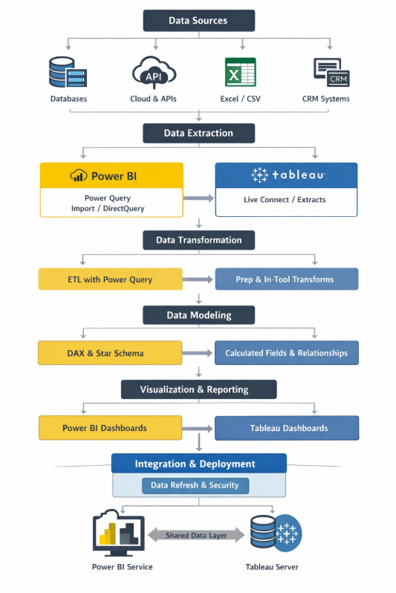
Working Process

Slide 16
Overview – Power BI
Objective
To prepare raw sales data for analysis using Power BI by performing initial data cleaning and transformation.
Tools Used
Power BI Desktop
Power Query Editor
Work Performed
Imported a structured Excel dataset into Power BI
Accessed Power Query Editor to perform data preparation
Reviewed dataset structure and column consistency

Slide 17
Data Cleaning & Transformation (Power Query)
Data Cleaning Steps Performed
Renamed columns for better clarity (e.g., Order Date → Date)
Removed duplicate records to ensure data accuracy
Checked for missing and invalid values
Verified categorical fields such as Payment Mode and ensured consistency
Transformations Applied
Standardized column names and formats
Ensured dataset readiness for further analysis

Slide 18
Learning Outcome
Key Learnings
Understood how Power Query is used for real-world data cleaning
Learned the importance of removing duplicates and validating values
Gained hands-on experience with Power BI’s data transformation workflow
Current Status
Dataset is cleaned and structured
Ready for further steps like data modeling and visualization

Slide 19
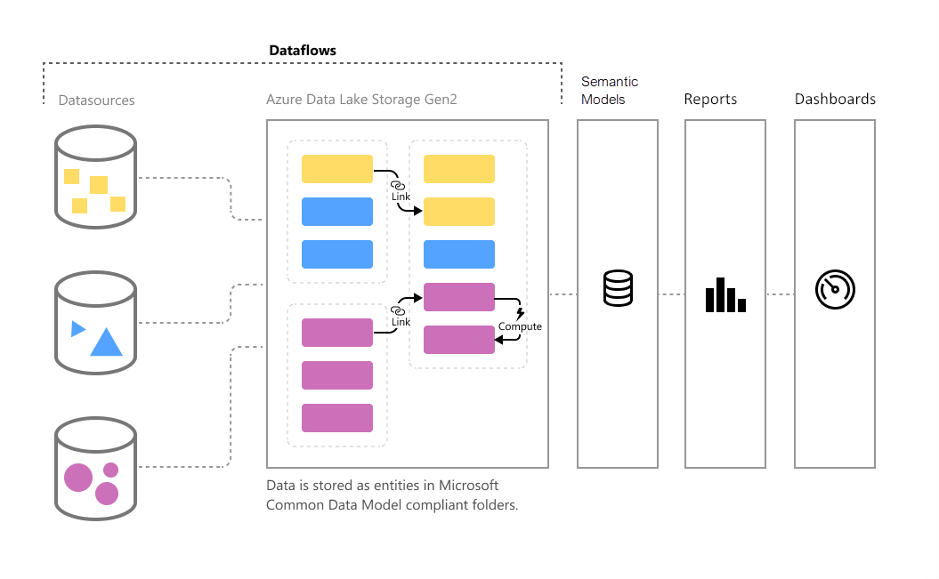
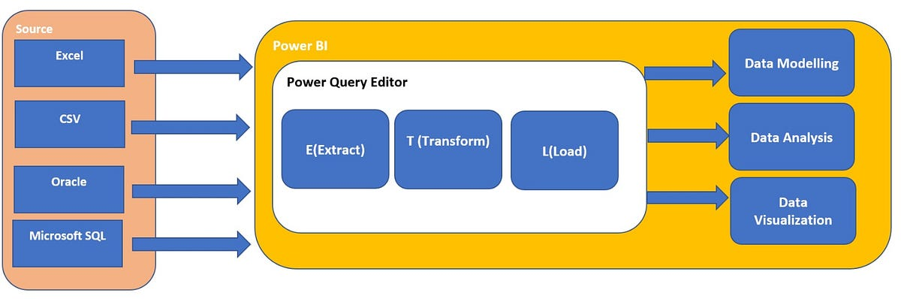
Architecture

Slide 20
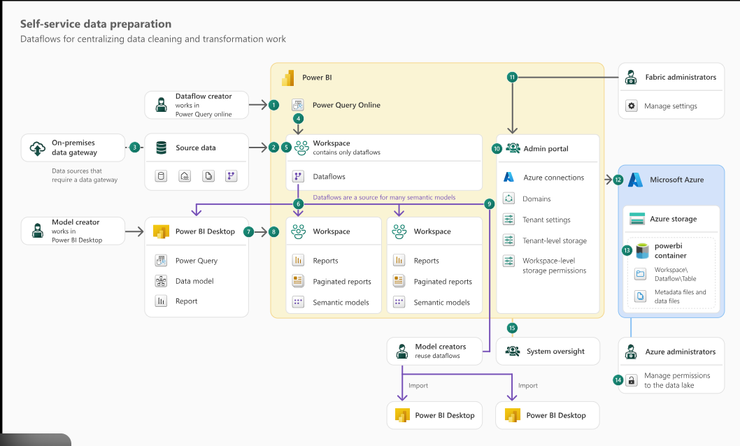

Slide 21
Visualization and Deployment
Dashboards and reports are created for business users using:
Power BI Reports and Dashboards
Tableau Interactive Visualizations
Reports are published to:
Power BI Service
Tableau Server

Slide 22
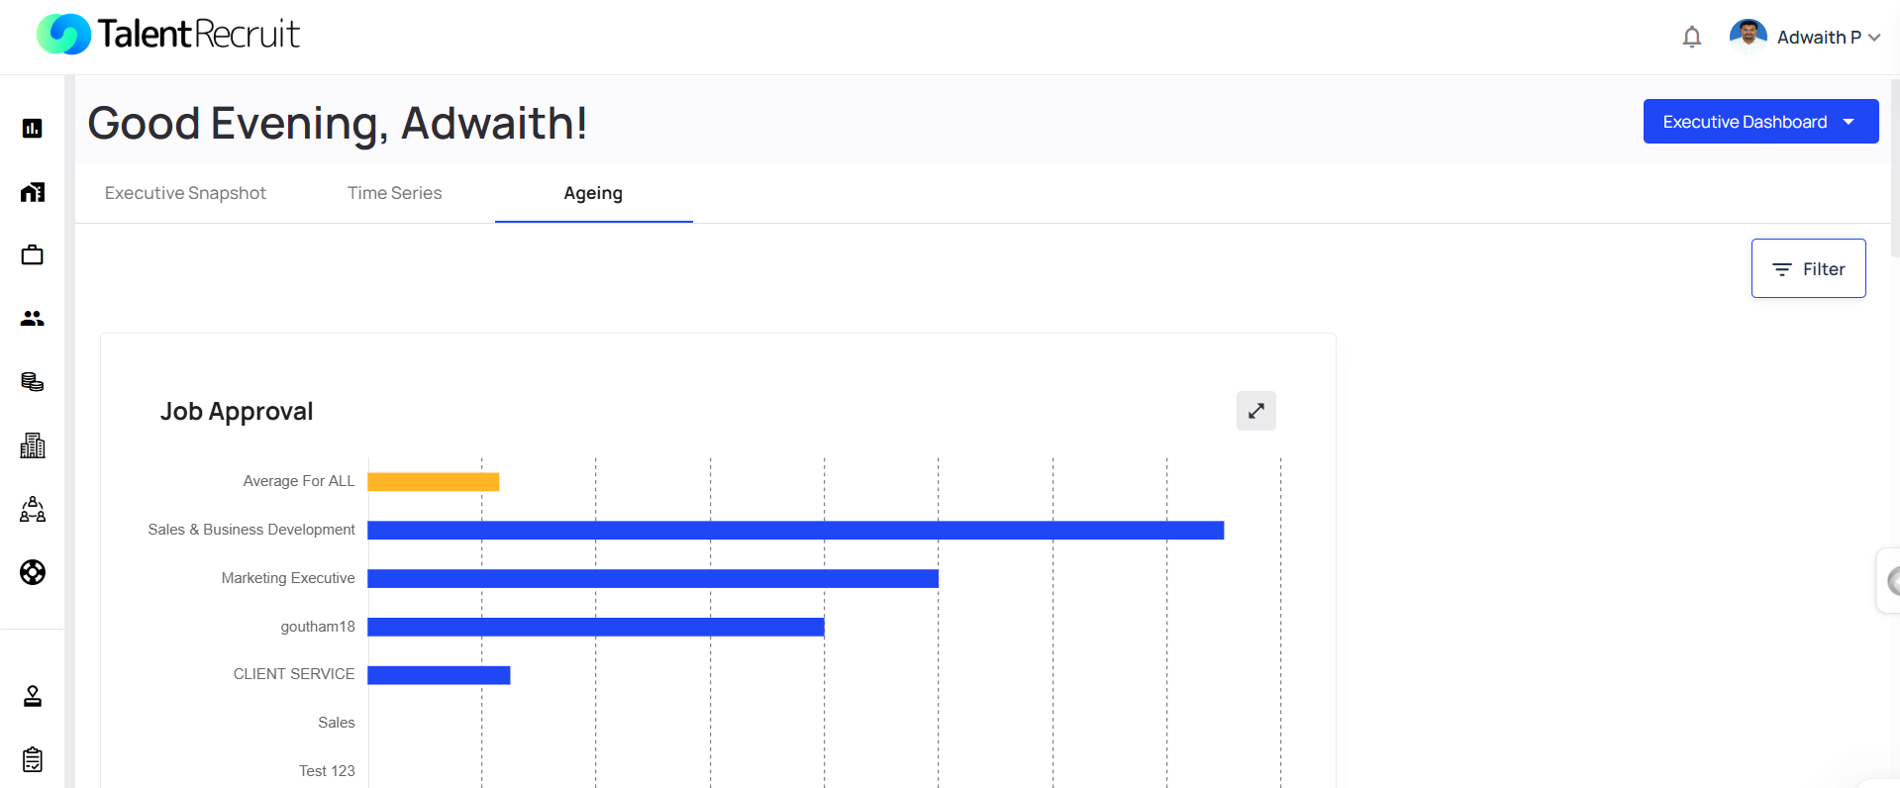
Advanced Analytics

Slide 23
Internship Road Map
Note: Write in the below table what u will be achieving in each review
Review 1
Product training and understanding the mechanisms
Review 2
Integrating all Advanced Analytics tools to the environments.
Review 3
Review 4
Final Review

Slide 24
Github Link
https://github.com/Jann-2004/Internship-Work-Adwaith_20221CBC0017

Slide 25
Q&A

Slide 26
Thank you !!

